Slide 1
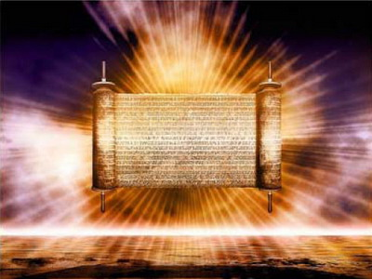
The New Covenant
Dr. Rick Griffith • Jordan Evangelical Theological Seminary • BibleStudyDownloads.org
Notes:
Godly Jews under the old covenant certainly had a relationship with God, and Christians today do as well

Slide 2
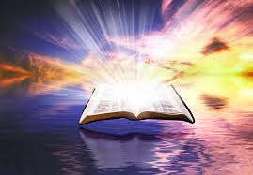
Old vs. New Covenants
Notes:
But the nature of these relationships is quite different. Our new covenant with him is much better than the agreement that Israel had with God. But how is it different?

Slide 3
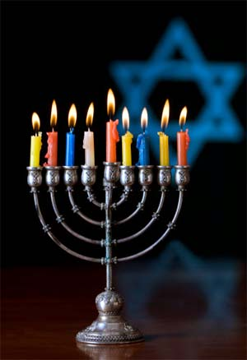
How is the new covenant better than the old?
Notes:
Yet they still needed to know how this new covenant was better than the old

Slide 4
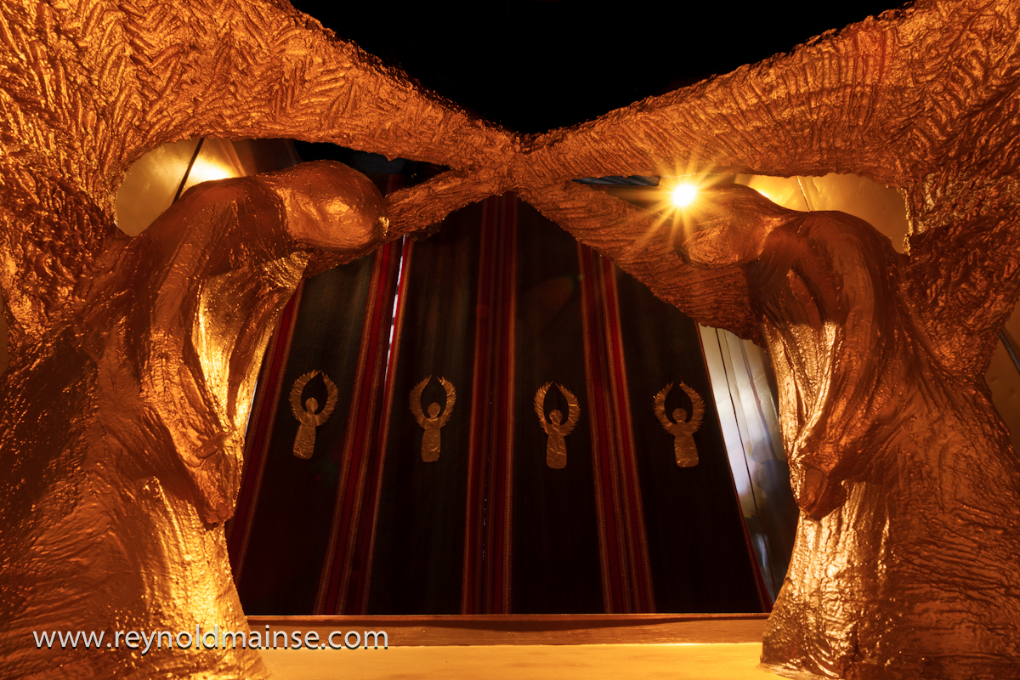
How is the New Covenant Better? (Hebrews 8)
Notes:
Hebrews 8 gives these two ways that the new covenant is better than the old.
How is the new covenant better than the old?

Slide 5
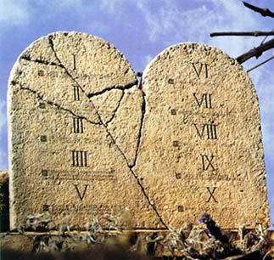
"Old" Replaced by "New"
266hh
Wayne Grudem, Systematic Theology, 521
"What then is the 'old covenant' in contrast with the 'new covenant' in Christ? It is not the whole of the Old Testament, because the covenants with Abraham and David are never called 'old' in the New Testament. Rather, only the covenant under Moses, the covenant made at Mount Sinai (Ex. 19-24) is called the 'old covenant' (2 Cor. 3:14; cf. Heb. 8:6, 13), to be replaced by the "new covenant" in Christ (Luke 22:20; 1 Cor. 11:25; 2 Cor. 3:6; Heb. 8:8, 13; 9:15; 12:24)."
Notes:
What covenant does Jesus mediate that is far better than the old (8:6)?

Slide 6
Views on New Covenant Fulfillment
View | Explanation | School & Scholars | Problems
Restated Mosaic | No New Covenant | Critical: –Couturier –Duhm –Schmidt –Potter | 1. OC/NC distinctions in text ignored 2. OC = conditional, NC = unconditional 3. OC = temporal, NC = eternal 4. OC = external, NC = internal 5. OC = no enablement, NC = enablement 6. NC = peace, prosperity, sanctuary, Spirit (parallel passages)
Church Alone | No Israel Participation | Amillennial/ Postmillennial: –Allis –Cox –Smick –Boettner | 1. Ignores OT data by equating Israel & the Church 2. NC introduced ≠ fulfilled to Israel 3. Present need to know YHWH (we still need to obey the Great Commission) 4. AD 70 Jerusalem vs. Jer. 31:40
166d

Slide 7
Views on New Covenant Fulfillment
View | Explanation | School & Scholars | Problems
Israel Alone | No Church Participation | Misc/Classical Dispensational: –Darby – Thompson –von Rad | 1. Ignores NT data –Christ's Last Supper words –Paul's statements –Hebrews application to Church 2. Ignores present work of Spirit
Two New Covenants | NC for Israel + NC for Church | Early 1900s Dispensational: –Chafer –Walvoord (old) –Ryrie (old) | 1. Same terminology for OT & NT NCs 2. Israel/Church distinction too sharp 3. Basis of forgiveness the same 4. If 2 NCs then no OC for Church 5. Church doesn't possess Israel's promises
166d

Slide 8
= My View on New Covenant Fulfillment
View | Explanation | School & Scholars | Problems
Church Participates | Primarily for Israel Secondarily for the Church | Misc/Present Dispensational: –Keil –Lemke –Bright –Scofield –Walvoord (DTS) –Ryrie (DTS) –Archer (TEDS) –Kaiser (TEDS) | Support: 1. Primary fulfillment is future— Rom 11 2. Deals with both OT & NT data 3. Forgiveness & the Spirit are blessings experienced now 4. NC has new law 5. Rebuttals to above views
166d

Slide 9
Sign of the Covenant with Noah

Slide 10
Signs of the Covenants
166e
Covenant | Definition | Promise | Fulfillment | Sign
Noahic | Unconditional promise not to flood earth again | Gen. 9:12-17 | No more sea (Rev. 21:1) | Rainbow (Gen. 9:12-17)
Abrahamic | Promise to provide Israel a land, rule, and spiritual blessing | Gen. 12:1-3; 15:13-18 | Continues at present (Gal. 3:17) but Israel still has a future (Rom. 11:25-27) | Circumcision (Gen. 17:11)
Mosaic | Conditional stipulations for blessing on Israel | Exod. 19-31; Deut. 28 | Death of Christ (Rom. 7:4-6) | Sabbath (Exod. 31:13)
Land | Promise of physical land from the Wadi of Egypt to the River Euphrates | Deut. 30:1-10 | Land blessed (Amos 9:13-15) | No sign (that I know of)
Davidic | Promise of eternal, political rule of a descendant of David | 2 Sam. 7:12-17 | Rule renewed (Amos 9:11-12) | Christ seated at the Father's right hand (Acts 2:34-36)
New | Promise of spiritual indwelling of the Spirit ("law written on hearts"), forgiveness, and total evangelization of Israel | Jer. 31:31-34 | Paul & the Apostles (2 Cor. 3–4) All Israel saved (Rom. 11:26-27) | Cup of the Lord's Supper (Luke 22:20; 1 Cor. 11:25)

Slide 11
The Old Covenant for Israel

Slide 12
The New Covenant is for the Church now (Jew and Gentile), but many more Jews will believe in Christ during the Tribulation

Slide 13
Contrasting the Covenants (2 Cor. 3–4)
166c
Old Covenant | New Covenant
initiated by Moses (3:8) | initiated by Christ (3:4)
of the letter (3:6a) | of the Spirit (3:6a, 18b)
kills (3:6b, 7a) | gives life (3:6b)
engraved on stone (3:3b, 7a) | engraved on hearts (3:3b; Jer. 31:33)
glorious (3:7a) | more glorious (3:8, 10)
glory faded (3:7b, 11a, 13b) | glory ever-increases (3:11b, 18)
condemns men (3:9a) | brings righteousness (3:9b)
deception (3:13) | boldness (3:12)
veiled face of Moses (3:13b) | unveiled faces (3:13a, 18a)
veiled minds (3:14a) | unveiled minds (3:14b; 4:3-6)
veiled hearts (3:15) | unveiled hearts (3:16)
dullness (3:14a) | freedom (3:17)
Moses reflected God's glory | all believers reflect Son's glory (3:17)
non-transforming (3:7) | transforming (3:18)
lack of zeal (3:13) | confidence, steadfastness (3:4-5; 4:1)
deception (3:13) | sincerity (4:2)

Slide 14
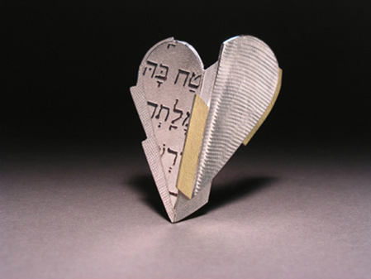
"I will put my laws in their minds, and I will write them on their hearts" (Heb 8:10b NLT).
Notes:
How would God put his law on people’s minds and write it on their hearts (8:10)?
This passage doesn’t say how this will happen.
Other texts tell us that the Holy Spirit will change us within.

Slide 15
How is the New Covenant Better? (Hebrews 8)

Slide 16
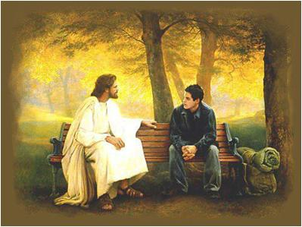
Main Idea of Hebrews 8
Our better priest gives us a better relationship with God.

Slide 17
Do you relate to Jesus as your compassionate, High Priest?
JESUS > RELIGION

Slide 18
Relationship, not rituals

Slide 19
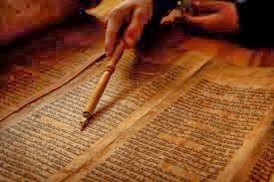
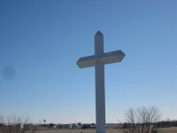
Which covenant is reflected in your life?

Slide 21
OT Backgrounds link at BibleStudyDownloads.org
Get this presentation for free!
Notes:
NT Survey (ns)

